Slide 1
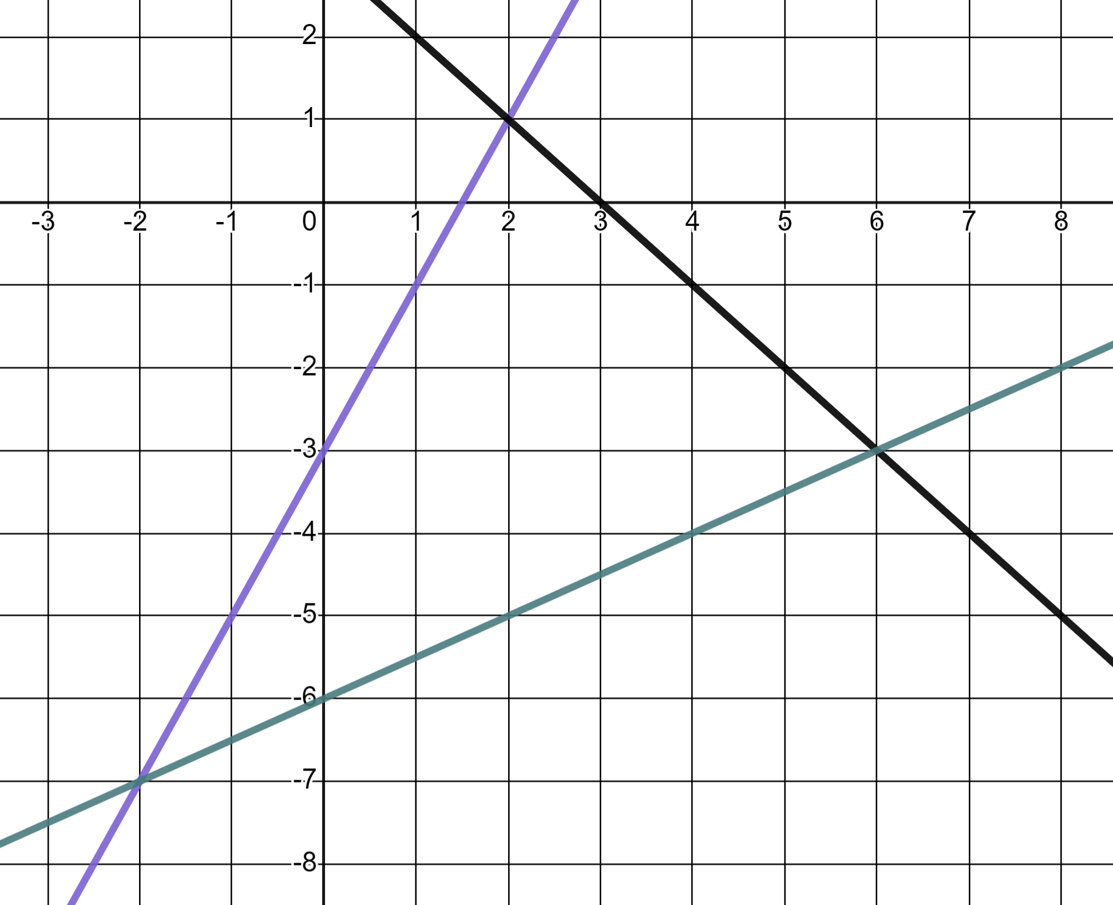
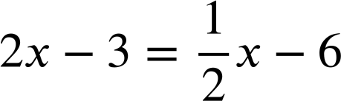
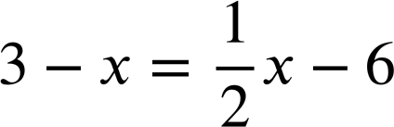
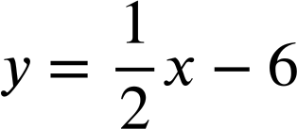
Graphically solving two linear graphs that intersect
Task A: Points of intersection
1) Use these graphs to solve the equations.
y = 2x − 3
a)
2x − 3 = 3 − x
b)
c)
y = 3 − x
2) Use the graphs to solve these pairs of simultaneous equations.
y = 2x − 3
a)
y = 2x − 3
y = 3 − x
b)
y = 2x − 3
c)
y = 3 − x
y = 3 − x

Slide 2
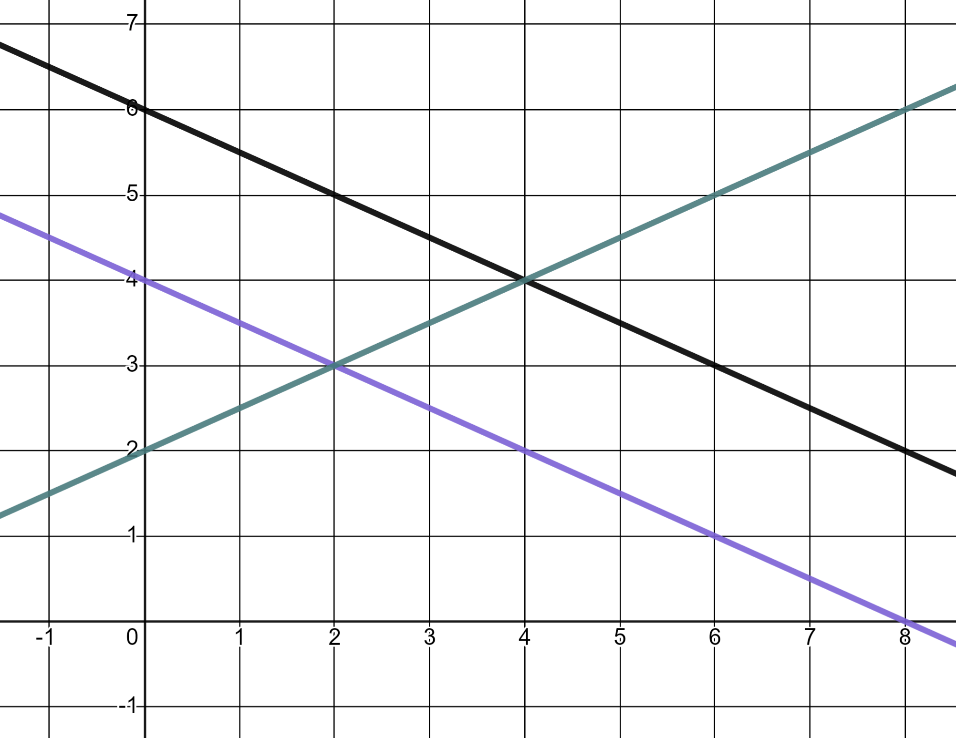
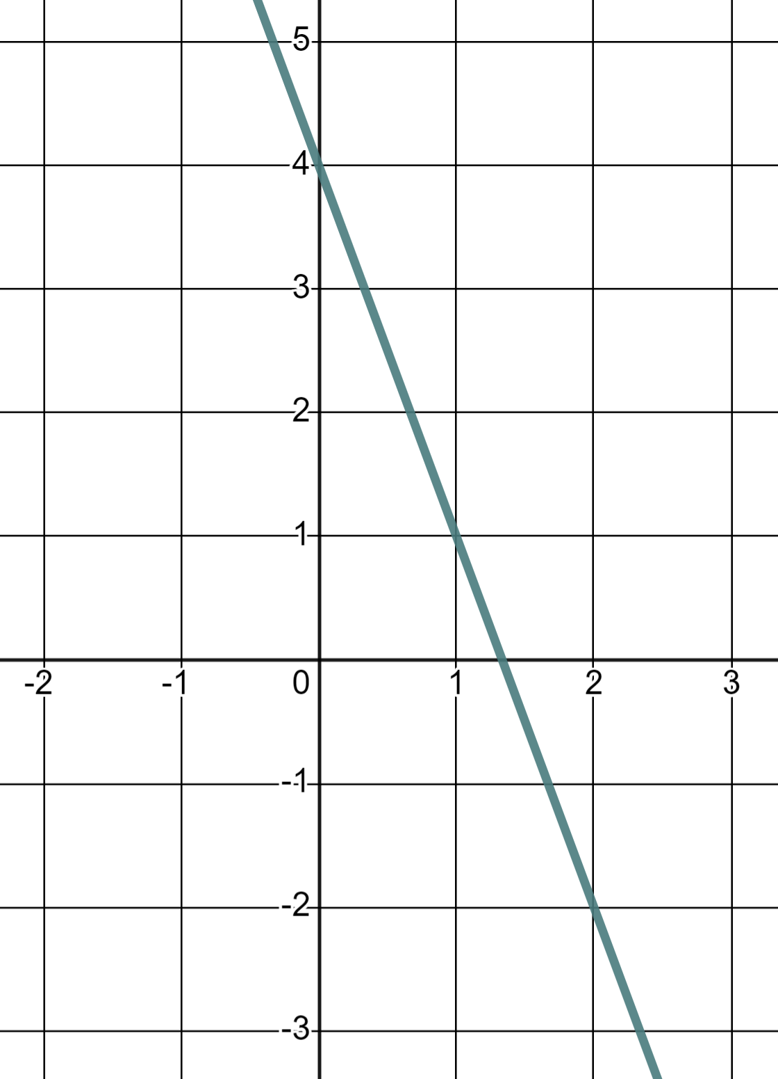
Graphically solving two linear graphs that intersect
3) a) Use the graph to identify two pairs of simultaneous equations which can be solved and find the solutions.
2x + 4y = 24
2y − x = 4
2x + 4y = 16
b) Explain why a third different pair of equations can not be found and solved using these particular lines.
Task B: Regions of a graph
1) Here is the graph of y = 4 − 3x
y
a) Mark and label three points where y = 4 − 3x
b) Mark and label three points where y < 4 − 3x
c) Mark and label three points where y > 4 − 3x
x

Slide 3
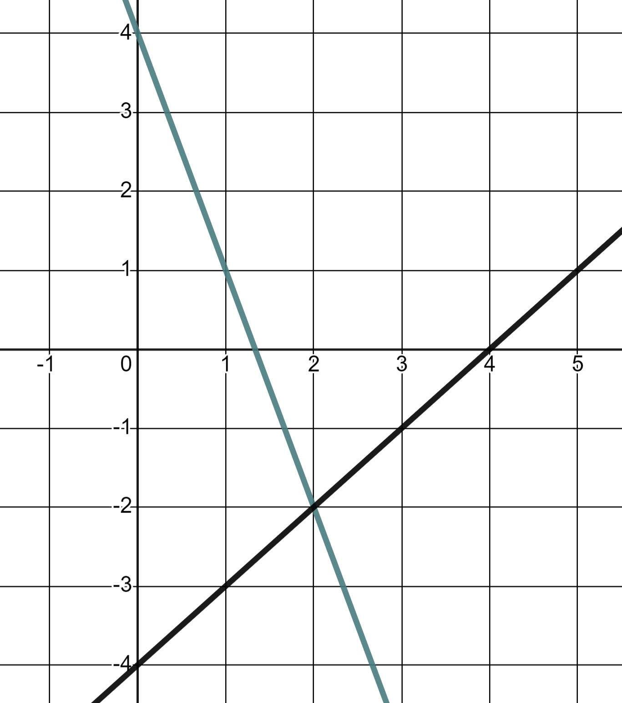
Graphically solving two linear graphs that intersect
2) The lines y = 4 − 3x and y = x − 4
y
a) Mark and label three points where y = 4 − 3x and y > x − 4
b) Mark three coordinates where y < 4 − 3x and y = x − 4
x
c) Mark and label the one point where y = 4 − 3x and y = x − 4
Mathematics in Education and Industry
v2.3

